Slide 1
Now it is time to decide what user stories you will complete in the first sprint
Key to this paradigm, “its not done if I can’t see it run”.
So pick items that let you run and show something!

Slide 2
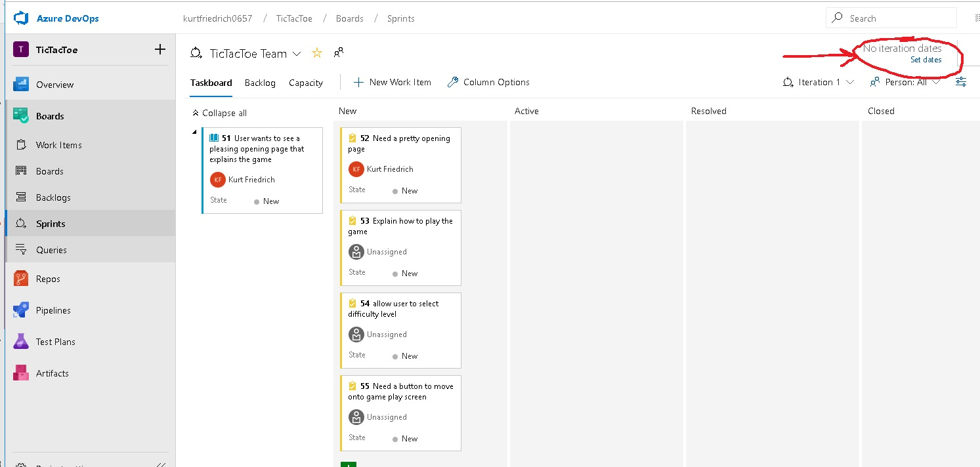

Slide 3
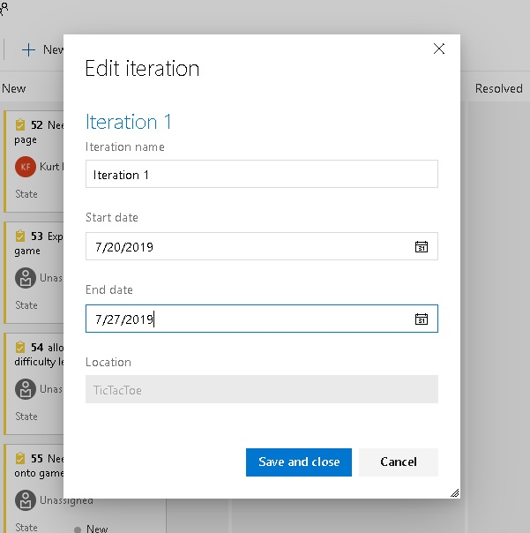
They call it an Iteration, I’ll use the word sprint.

Slide 4
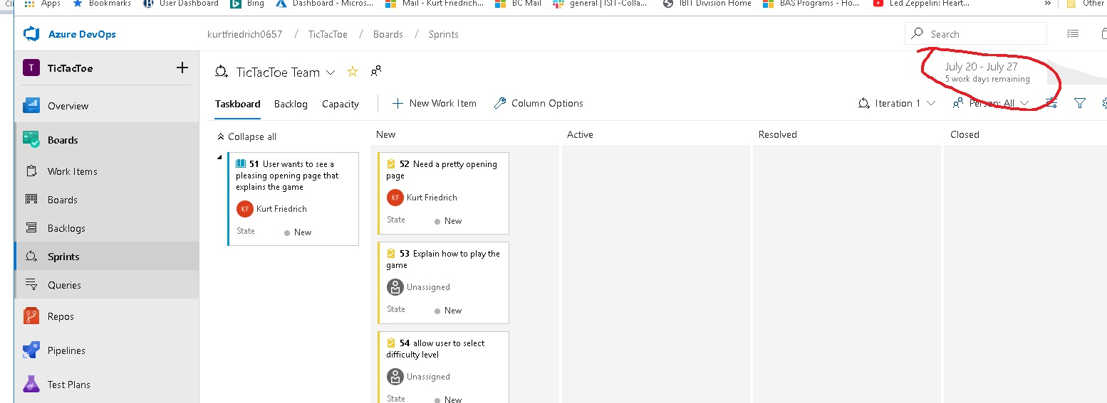

Slide 5
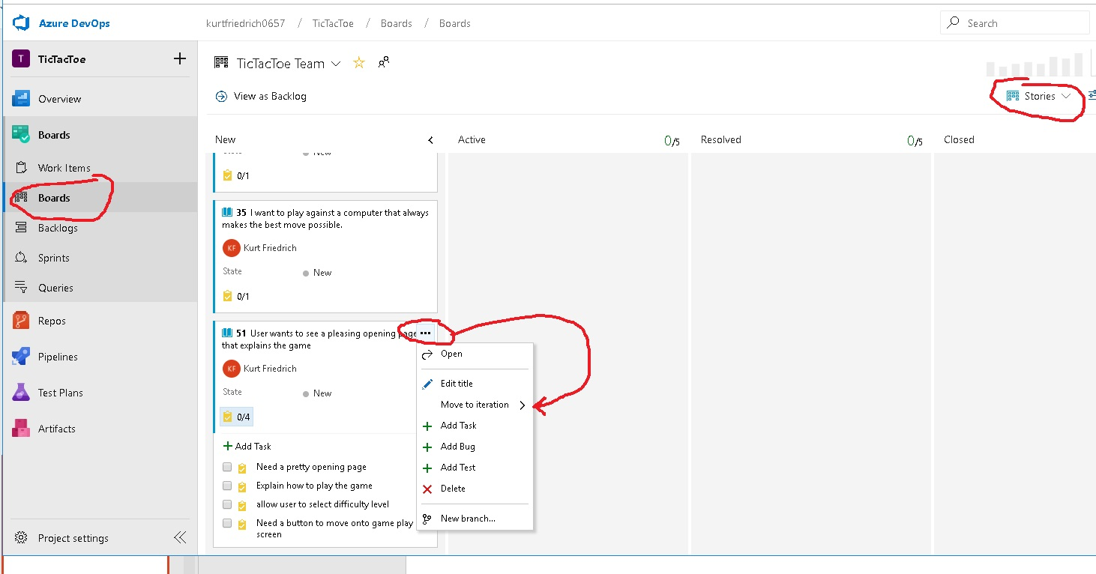

Slide 6
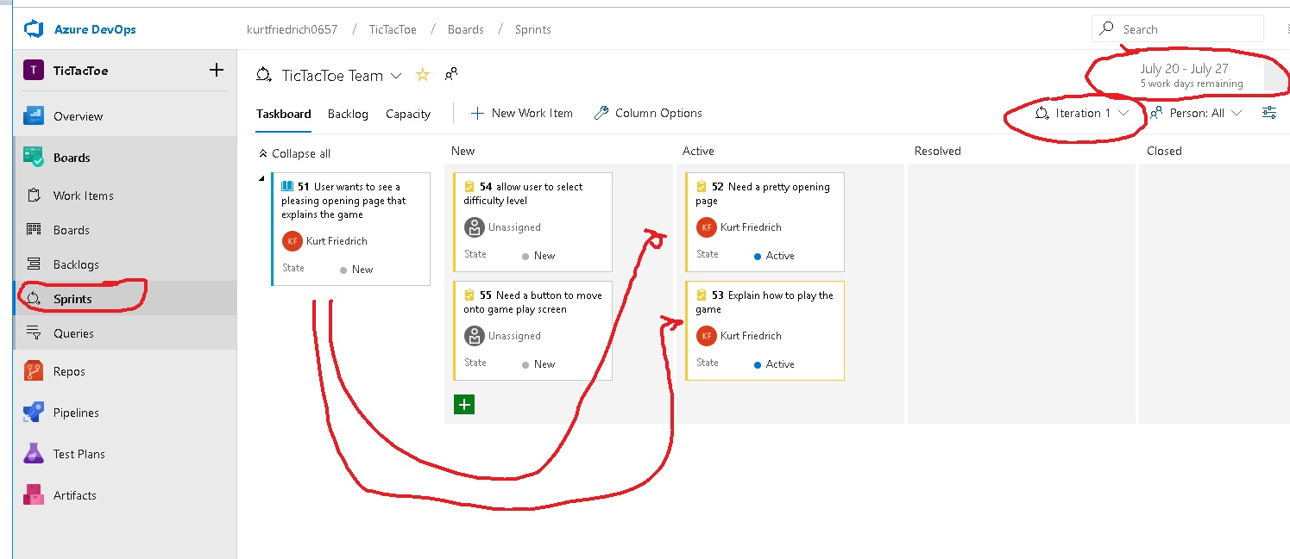

Slide 7
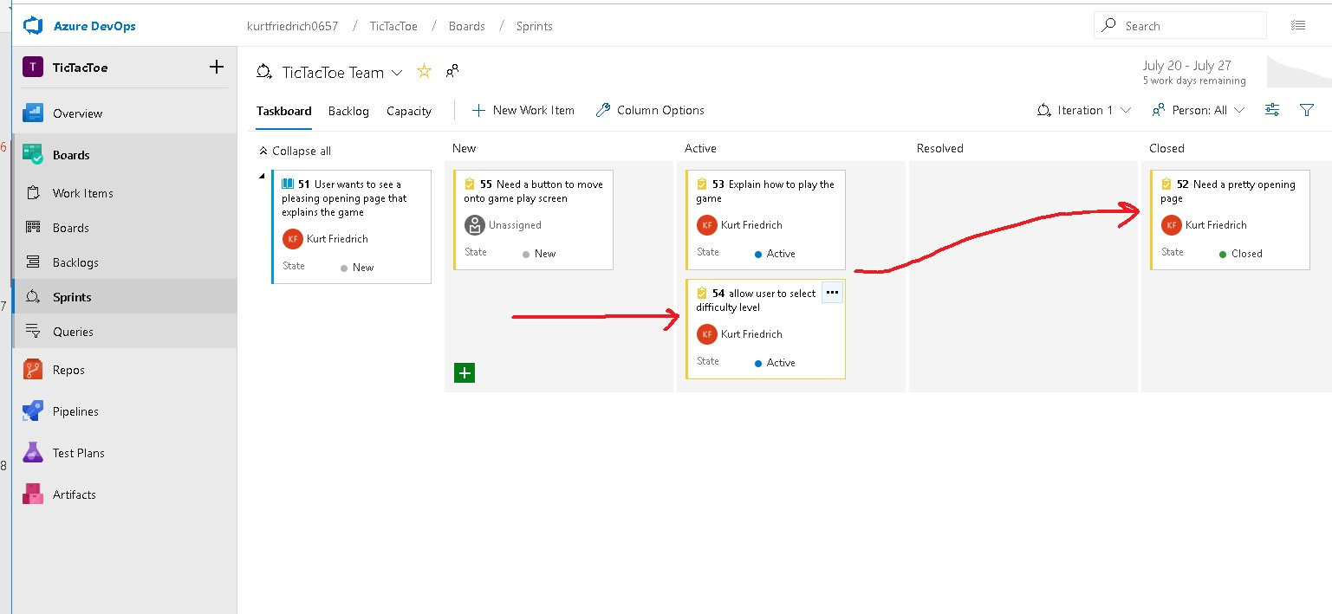
We won’t use the Resolved Column

Slide 8
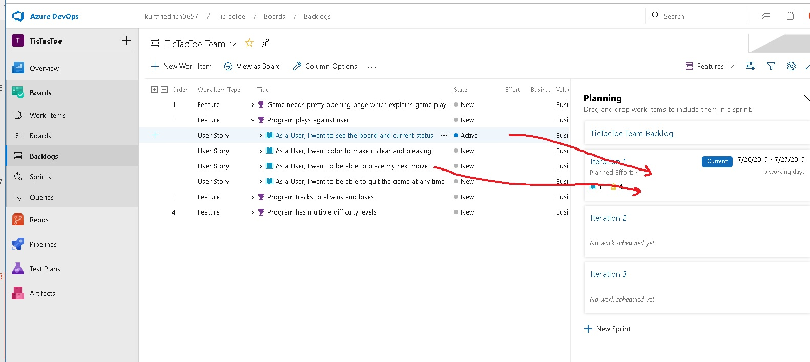

Slide 9
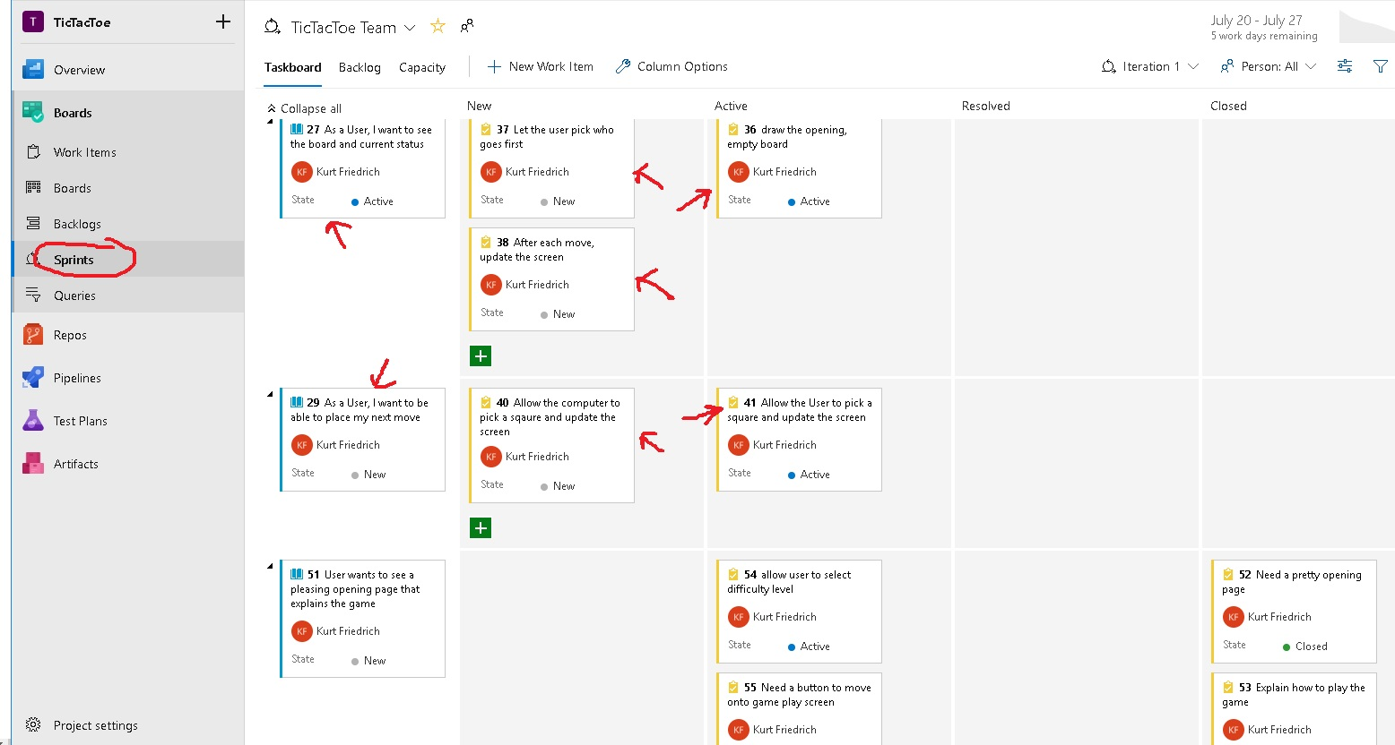

Slide 10
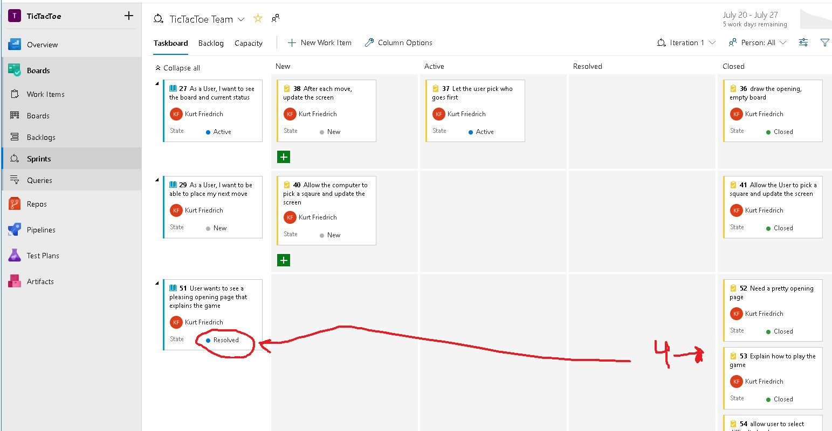

Slide 11
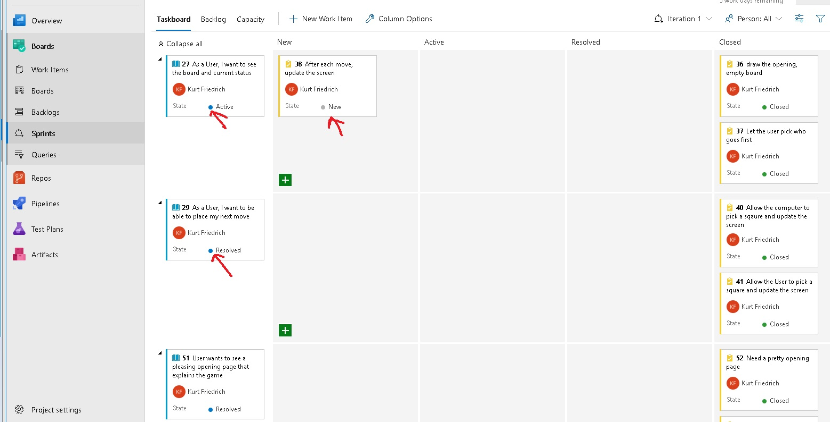

Slide 12
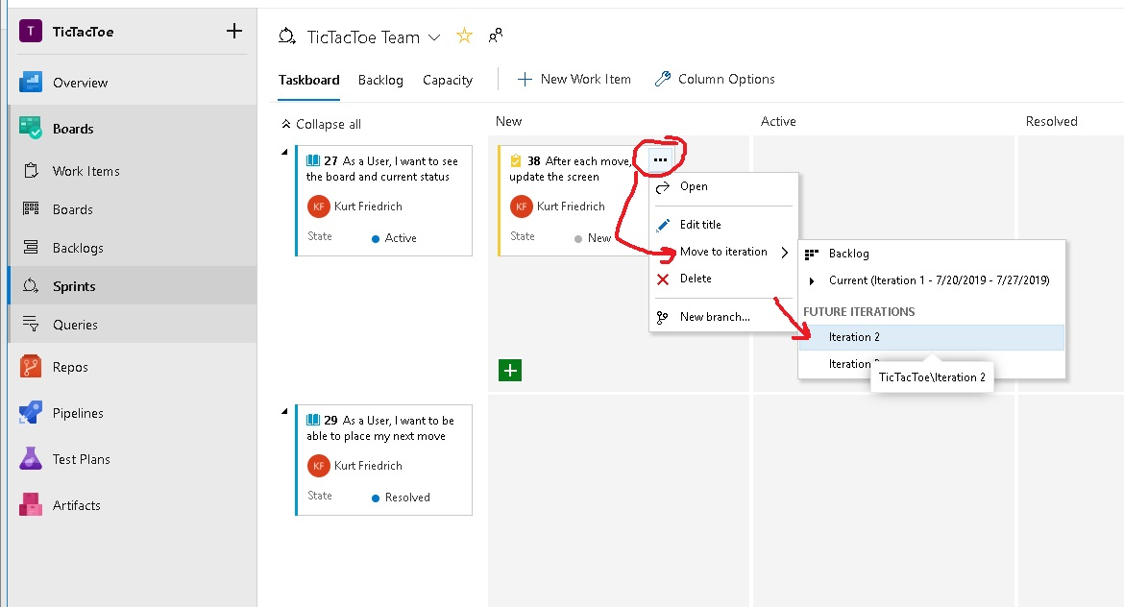

Slide 13
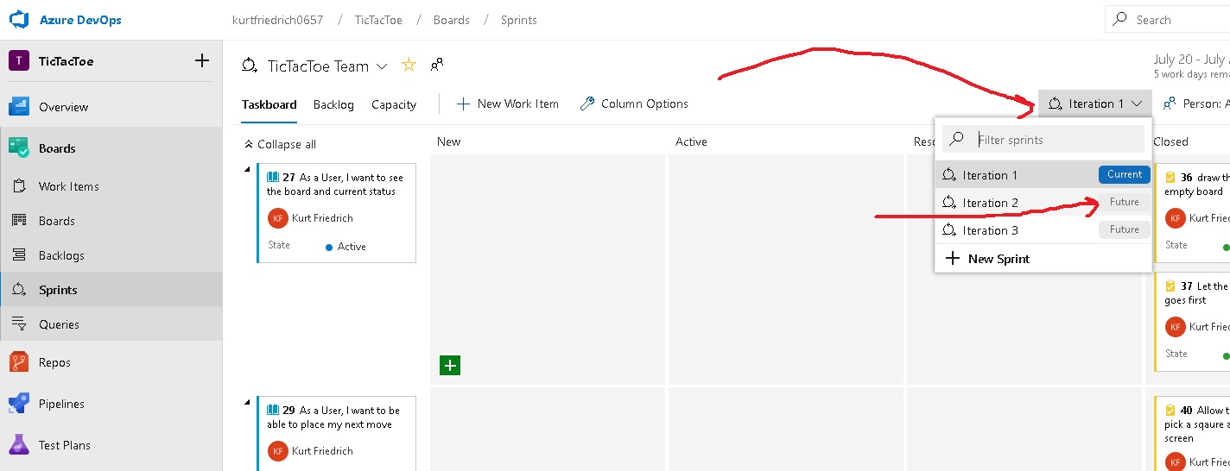

Slide 14
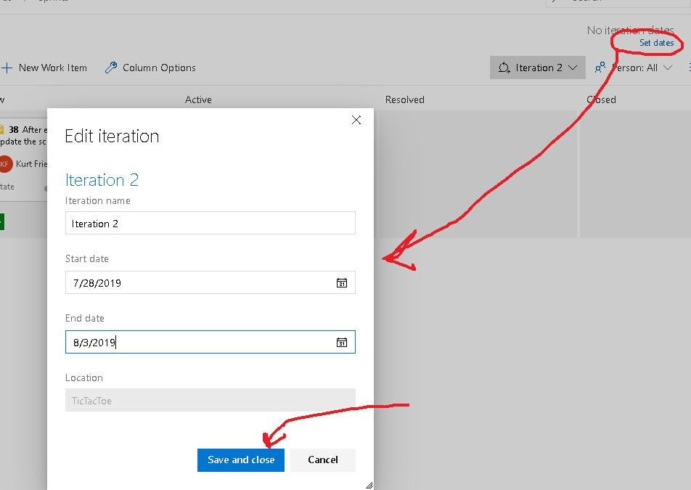

Slide 15
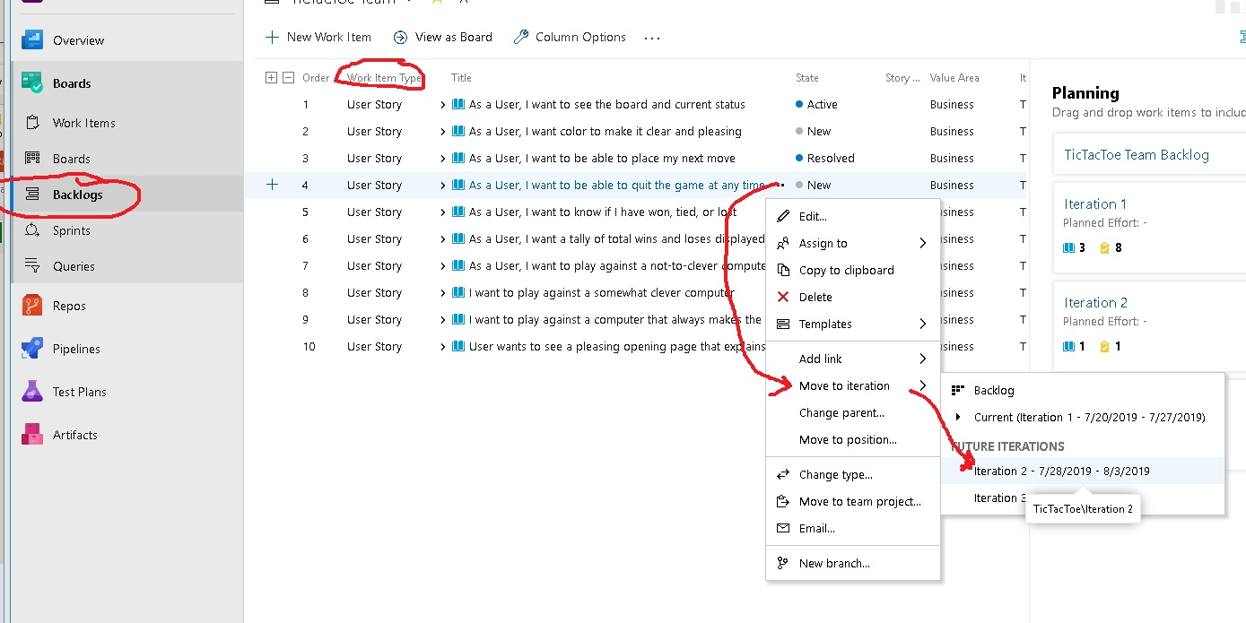

Slide 16
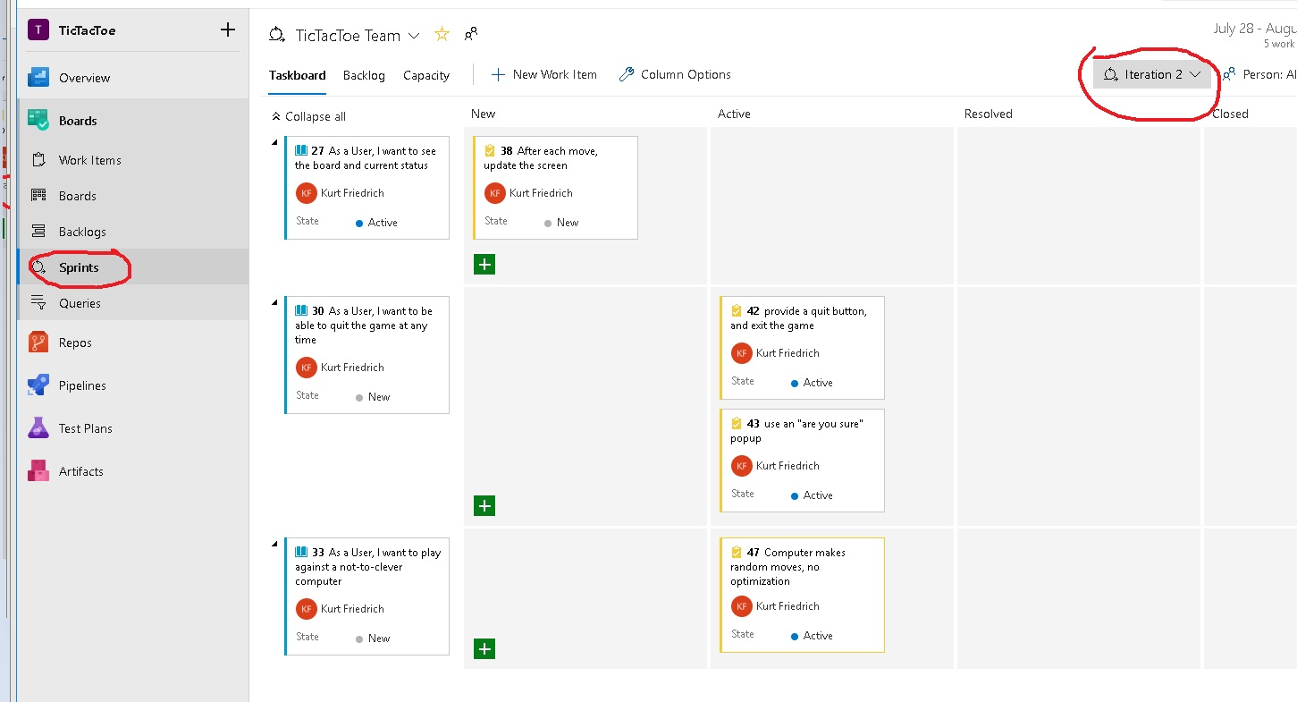

Slide 17
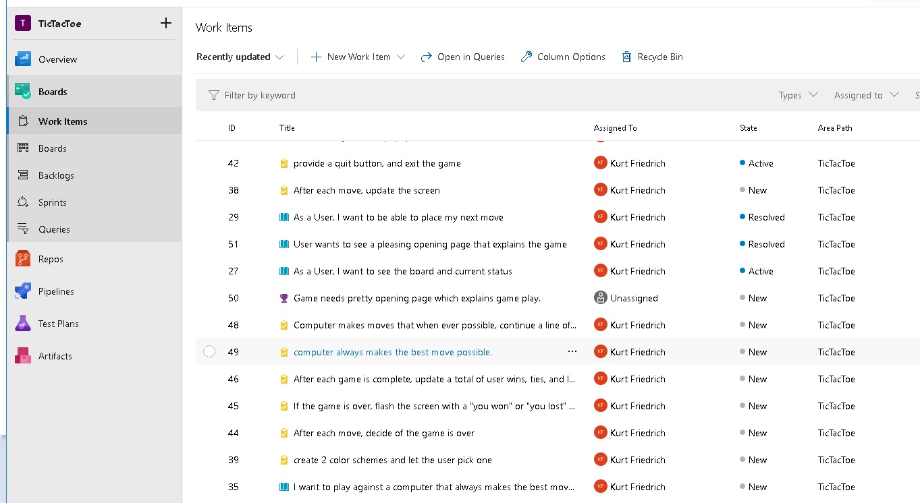

Slide 18
https://docs.microsoft.com/en-us/azure/devops/boards/backlogs/create-your-backlog?view=azure-devops
Your product backlog corresponds to your project plan, the roadmap for what your team plans to deliver. You create your product backlog by adding user stories, backlog items, or requirements.
After you define it, you have a prioritized list of features and requirements to build.
Your backlog also provides a repository of all the information you need to track and share with your team.
Your backlog consists of a list of work items. You use work items to share information, assign work to team members, track dependencies, organize work, and more. Because the most important work appears at the top of the list, your team always knows what to work on next.

Slide 19
https://docs.microsoft.com/en-us/azure/devops/boards/boards/kanban-quickstart?view=azure-devops
Your Kanban board turns your backlog into an interactive signboard, which provides a visual flow of work.
As work progresses from idea to completion, you update the items on the board.
Each column represents a work stage.
Each card represents a backlog item, user story, or bug at that stage of work.

